Slide 1
Analyzing Visual Rhetoric

Slide 2
A picture is worth a thousand words…
Can a picture communicate things that words cannot?
Would a newspaper made up of nothing but images be comprehensible?
Is communication more reliant on images now than it has been in the past?

Slide 3
What does analyzing visual rhetoric mean?
Analysis:
Detailed examination of the elements or structure of something
Visual:
A picture, piece of film, or display used to illustrate or accompany something
Rhetoric:
The art of effective or persuasive speaking or writing

Slide 4
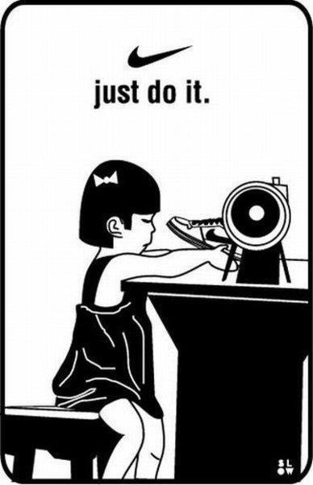
This image does not exist for its aesthetic appeal; it is making an argument
Savvy interpreters of the visual world will be able to “read” the image and understand its meaning

Slide 5
Analyzing Images
Visual texts can be analyzed in much the same way that written texts are analyzed
Text: anything that can be “read” or interpreted
In the previous image, irony is being used to reframe our understanding of Nike’s slogan, “just do it.”

Slide 6
Why do we need to be able to analyze the visual world?
Advertisements
Websites
Campaign posters
Paintings
Brochures/flyers
Film
Graphic Novels
Statuary
Architecture
Notes:
We spend more time each day looking at images than we do reading text

Slide 7
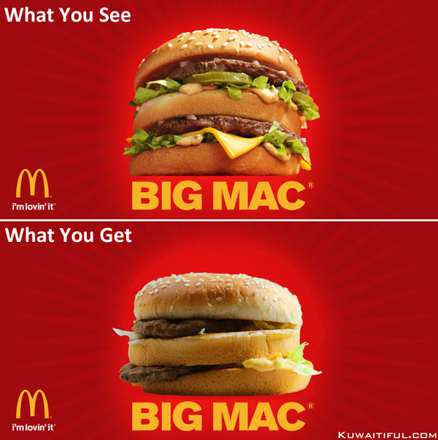
Notes:
We are often misled by images!

Slide 8
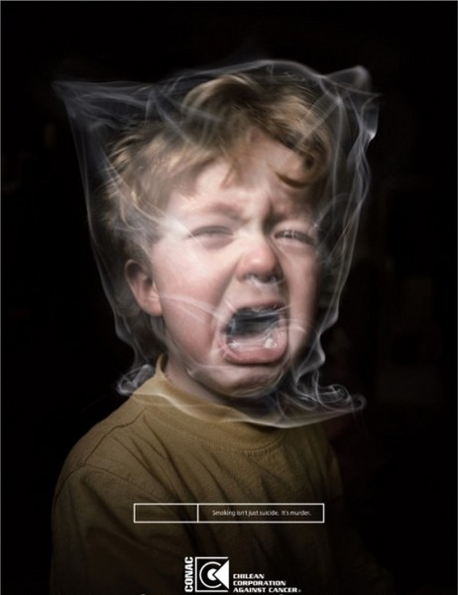
Images don’t always sell products
Sometimes they sell ideas

Slide 10
How to Analyze an Image: Step One
Describe the image.
Make note of any interesting features that stand out to you.
Pay attention to backgrounds, “camera” angles, iconography, fonts, and colors.

Slide 12
How to Analyze an Image: Step Two
Respond to the image.
What feelings does each visual element inspire?
Are there common associations related to each element?

Slide 14
How to Analyze an Image: Step Three
Tie all of the elements together into one unified meaning.
What is the overall message?

Slide 16
For graphic novels…
The same strategy applies; however, you must consider the larger narrative.
Consider these questions:
How does the meaning of the individual image relate to the meaning of the whole novel? Are there similarities? Differences?
What is the author’s intent? What do they want the reader to feel or think?

Slide 17
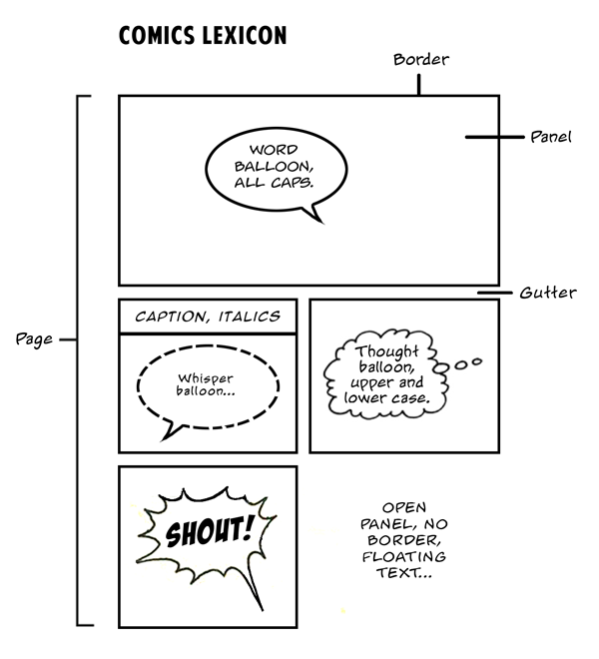
Talking about comics

Slide 18
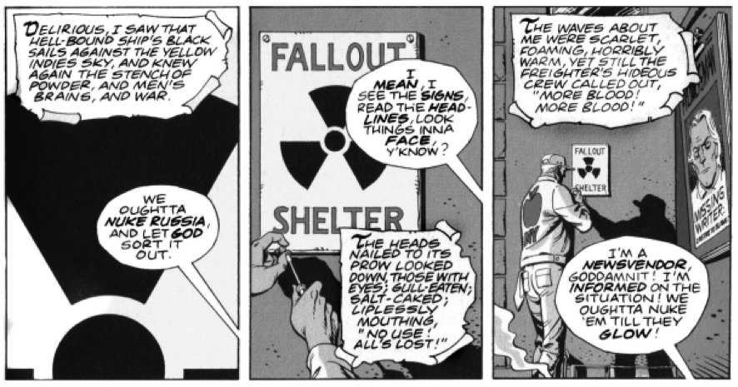

Slide 19
Let’s practice with Persepolis

